Slide 1
Heat Transfer
Thermal Management of a Circuit Board
Mechanical Engineering
Team Plan B
Austin Dionne
Greg Hovagim
Carlos Lazo
Nate Soule

Slide 2
Problem Statement
Perform thermal analysis of current circuit design
  Calculate steady-state temperature across the board
  Calculate steady-state junction temperature for each component
  Determine if the design meets junction temperature criteria
Produce an alternative circuit design
  Must meet thermal and design requirements
    Maximum junction temperature must be below 105°C
    Devices may not be placed within 0.25’’ of any edge, or any other device
  Provide thermal design recommendations

Slide 3
Assumptions
Top/bottom edges of board have zero heat flow
Board temperature for each device is the average temperature of the board under the device
All components operate continuously at a constant power dissipation
During operation, the temperature will remain constant at all points on the board, e.g. steady-state
Conduction across the board is two-dimensional
Thermal conductivity is constant across the board

Slide 4
Method of Analysis
Implemented the Finite Difference (FD) method using Excel to model the thermal profile of the circuit board
  Circuit board divided into 21x21 mesh of nodes spaced 0.5’’ apart
  Utilized Successive Over-Relaxation technique to decrease settling time
    Attempted different SOR values to see which experiment yielded the smallest amount of code iterations
  Initial temperature for each node was set to 100°C
    Estimated based on expected steady-state temperature
  Junction temperatures calculated once steady-state was achieved

Slide 5
Method of Analysis cont’d
Convergence Criteria
  Steady-state temperature difference threshold of 0.001°C
    Chosen small enough to provide sufficient accuracy and large enough to minimize run time

Slide 6

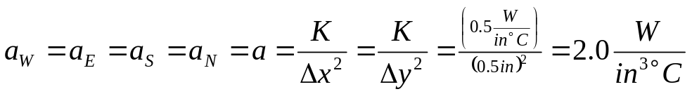
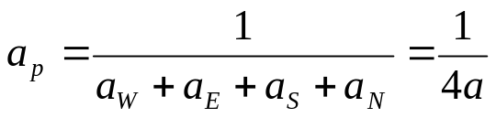
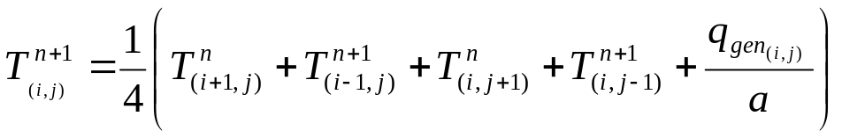
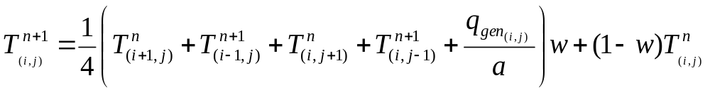
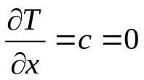
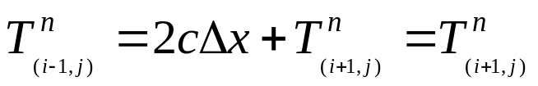
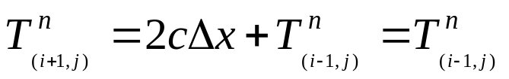
Method of Analysis – Equations Used
Distances Between Nodes
FD Coefficients
FD Iteration Equation
Weighted FD Iteration Equation
Top/Bottom Edge Assumption
Temp. at Top/Bottom Edge

Slide 7
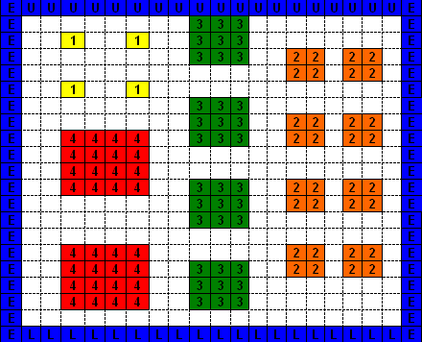

Results - Original Design
Component Arrangement:
U13
U1
U2
U5
U6
U3
U4
U14
U7
U8
U17
U15
U9
U10
U18
U11
U12
U16
SOR Value = 1.8
*** See Appendix for SOR Graph ***

Slide 8
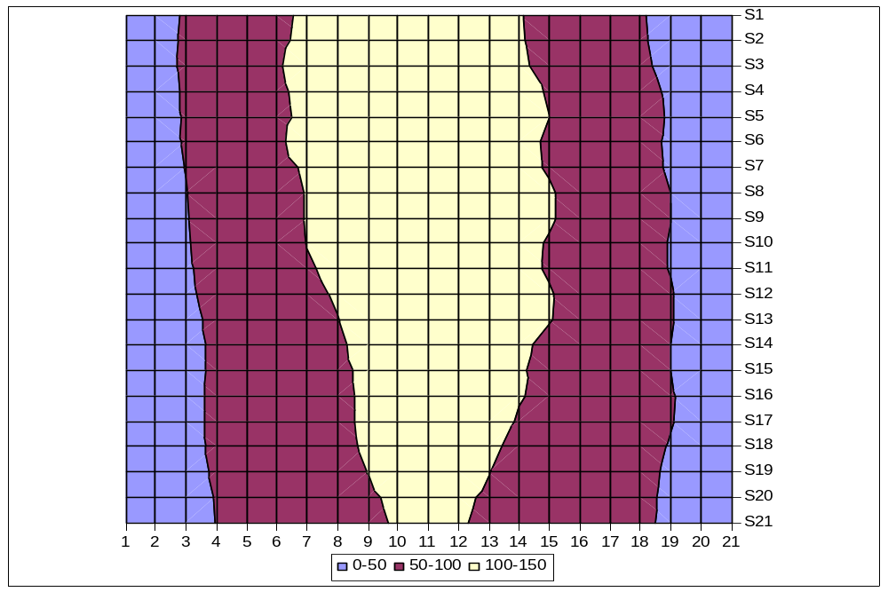
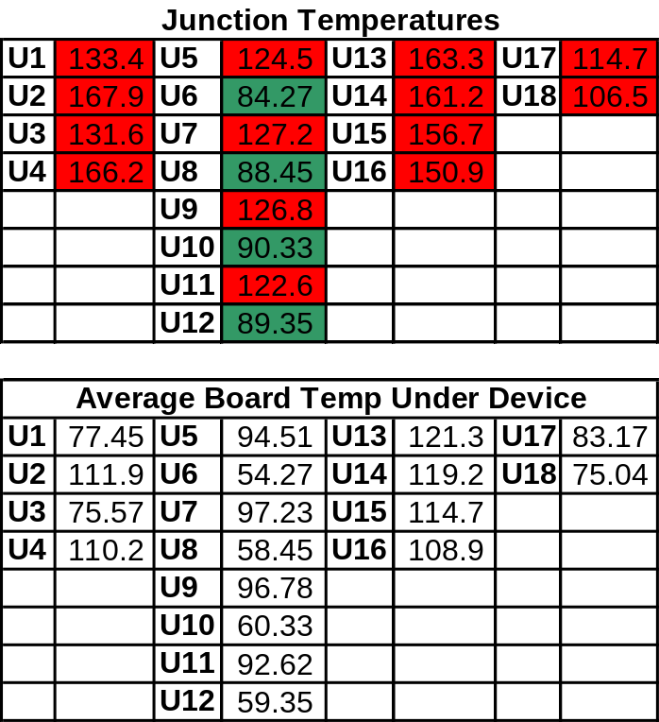
Results - Original Design cont’d
Thermal Profile
U13
U1
U2
U5
U6
U3
U4
U14
U7
U8
U17
U15
U9
U10
U18
U11
U12
U16
Temp, °C
*** SEE APPENDIX FOR BOARD TEMPERATURE LAYOUT ***
Temp, °C

Slide 9
Results - Original Design cont’d
Almost all component junction temperatures exceeded maximum allowable junction temperature!
  No components were adjacent to the cooling edge
  Component heat generation was not considered
  Layout created a center hot-spot

Slide 10
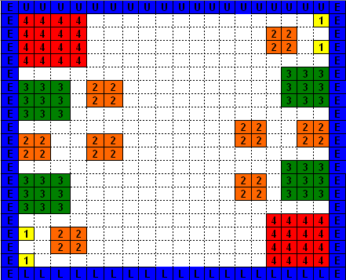
Results - Plan B PCB Layout
New Component Arrangement (Plan B):
U17
U1
U5
U2
U13
U14
U6
U7
U8
U9
U10
U15
U16
U11
U18
U3
U12
SOR Value = 1.8
*** See Appendix for SOR Graph ***
U4

Slide 11
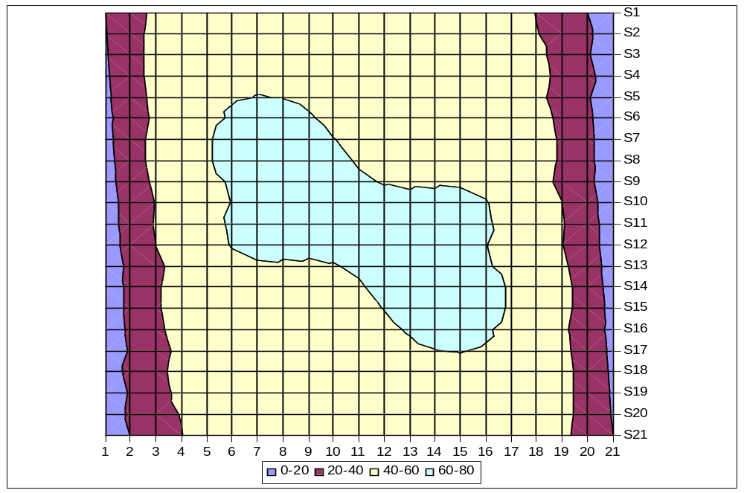
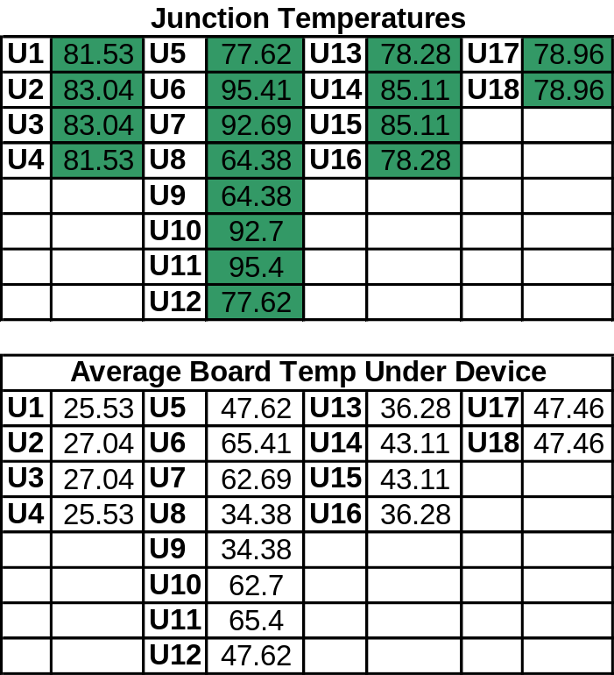
Results - Plan B PCB Layout cont’d
Thermal Profile
U17
U1
U5
U2
U13
U14
U6
U7
U8
U9
U10
U15
U16
U11
U18
U3
U12
U4
*** SEE APPENDIX FOR BOARD TEMPERATURE LAYOUT ***
Temp, °C

Slide 12
Results - Plan B PCB Layout cont’d
All component junctions temperatures did not exceed maximum allowed temperature!
  New layout placed components along cooling edge
  Considered each component’s heat generation
  Avoided placement towards the center where heat dissipation is the most difficult

Slide 13
Specific Suggestions for Re-design
  If cooling source is available, place the hottest components near it (greatest power dissipation)
  Consider the heat generation for each component
  Avoid component placement towards the center where heat dissipation is the most difficult

Slide 14


Slide 15
Appendix – Data
  Temperature Fields
  Iterations versus SOR factor

Slide 16
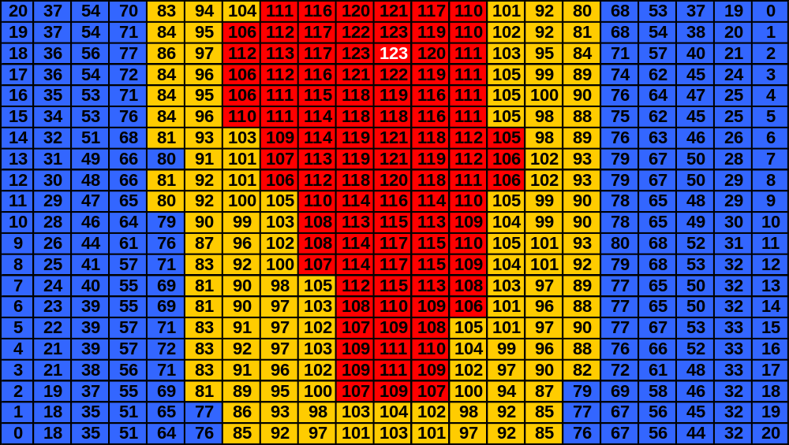
Temperature Field – Original Design
Max Temperature is 123.36 °C

Slide 17
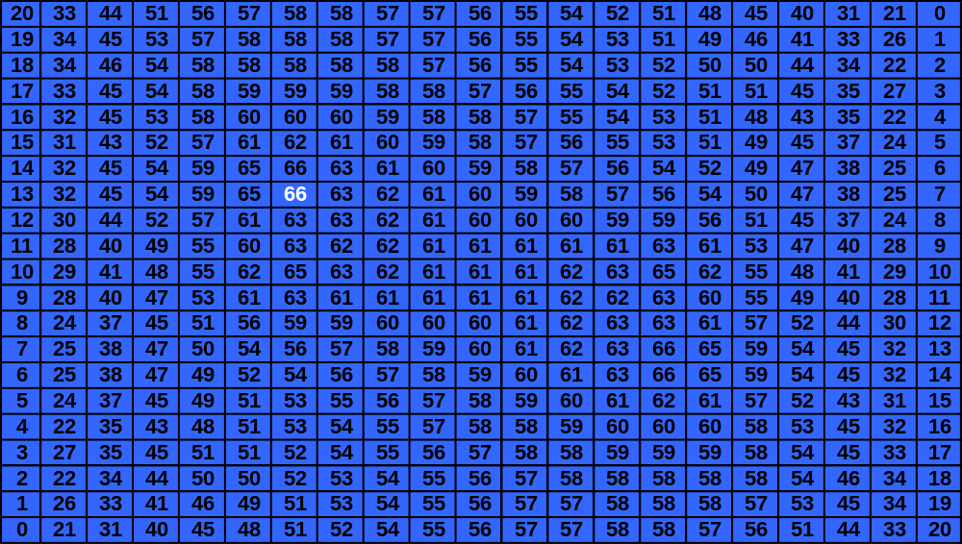
Temperature Field – Plan B Design
Max Temperature is 66.35 °C

Slide 18
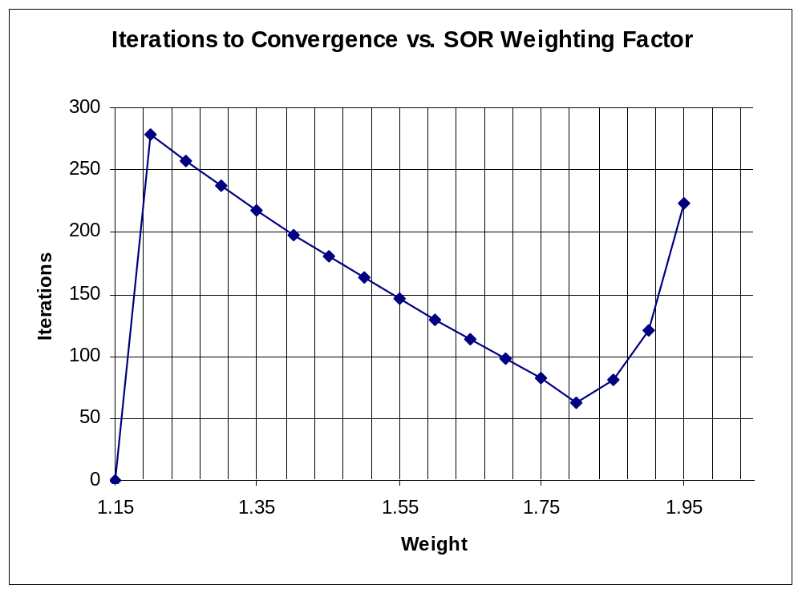
Successive Over-Relaxation (SOR)
Weight | Iterations
1 | -
1.05 | -
1.1 | -
1.15 | -
1.2 | 279
1.25 | 257
1.3 | 237
1.35 | 217
1.4 | 198
1.45 | 181
1.5 | 163
1.55 | 147
1.6 | 130
1.65 | 114
1.7 | 98
1.75 | 82
1.8 | 63
1.85 | 81
1.9 | 121
1.95 | 223
2 | -

